Slide 1
Introduction to
PYTHON

Slide 2
Table of Content
Why Python
Applications of Python
Python and its features
Packages overview
NumPy
Pandas
Scikit Learn
Matplotlib
Seaborn
TensorFlow
Installation steps
Jupyter Notebook for Python and shortcuts

Slide 3
Python’s Benevolent Dictator For Life
“Python is an experiment in how much freedom programmers need. Too much freedom and nobody can read another's code; too little and expressiveness is endangered.”
- Guido van Rossum
Notes:
Image source:- https://commons.wikimedia.org/wiki/File:Guido_van_Rossum_2006.jpg
Share the credit under the image. This is CC2.0

Slide 4
Why Python
Easy to understand
Free and open source
Huge community support
Robust standard libraries
Wide range of applications
Fast edit-test-debug cycle
Portable
Scalable

Slide 5

Application Of Python
Software development
AI/ML & visualization
Data science & analytics
GUI
Web development
Game development
Notes:
Diagram created internally

Slide 6





Application Of Python
Large section of YouTube video sharing system is written in Python.
NASA uses Python to perform many specific tasks.
Web search system uses Python.
Server & Client software of Dropbox storage use Python.
Peer to peer file sharing system started with Python.
Notes:
Logos are taken from wikimedia commons
E.g.: https://commons.wikimedia.org/wiki/File:BitTorrent_logo.svg
Good to go

Slide 7
Python & Its Features
Object oriented programming
Interpreted language
High-level programming
Dynamic semantics
High-level built in data structures
Automatic garbage collection

Slide 8
Python Built-in Data Types
Boolean
Bool
0,1,True,False
Text
Str
‘python’
“python”
Numeric
int, float, complex
10, 10.67, 10+2j
Python data types
List
[1,”A”,[2,4]]
Sequence
Tuple
(1,2,3,4)
Mapping
Dict
{“name” : “python”, ”number”:1}
Set
{1,2,3,4}
Set
Binary
b"Hello"
bytes
Notes:
Diagram created internally

Slide 9
Python Operators
+,-
Arithmetic operators
=, +=
Assignment operators
<,>
Relational operators
and, or
Logical operators
Is, is not
Identity operators
In, not in
Membership operators
&,^
Bitwise operators
Notes:
Diagram created internally

Slide 10
Python Tokens
Small units of the programming language
Keywords
Punctuators
Identifiers
Tokens
Operators
Literals
Notes:
Diagram created internally

Slide 11
List, Tuples, Dictionary & Set
Apart from data types like int, string, float Python has the below data types which are very useful for data science -
List - Lists are used to store multiple items in a single variable.
Tuples - Tuples are used to store multiple items in a single variable
Dictionaries - Dictionaries are used to store data values in key : value pairs. A dictionary is a collection which is ordered*, changeable and do not allow duplicates
Set - A Set is an unordered collection data type that is iterable, mutable, and has no duplicate elements.
Tuples
Sets
( )
{ }
[ ]
{ }
Lists
Dictionaries

Slide 12
Packages Overview
A Python package usually consists of several modules.
Has Build-in modules & Open source modules.
NumPy, Pandas, Scikit Learn, Matplotlib, Seaborn, SciPy, TensorFlow, Keras, and many more.
Pandas
NumPy
Scikit Learn
Matplotlib
Seaborn
Notes:
Logo taken from wikimedia commons & Diagram created internally
Link: https://commons.wikimedia.org/wiki/File:Python_logo_and_wordmark.svg

Slide 13
OPEN SOURCE PACKAGES

Slide 14
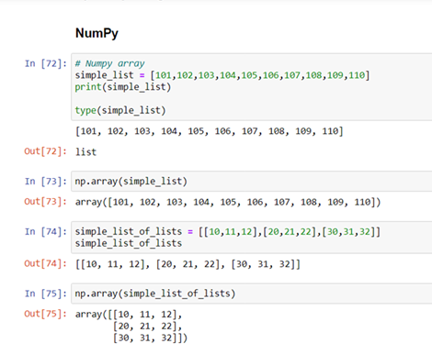
1. NumPy
Adds support for large, multi-dimensional arrays and matrices, along with a large collection of high-level mathematical functions to operate on these arrays.
Open source library
Notes:
Screenshot is taken from a personal notebook

Slide 15
2. Pandas
Mainly used for structured data operations and manipulations.
Offer powerful data processing capabilities, open source library.
Reading various forms Datasets (CSV, Excel, etc)
Reshaping Datasets
Manipulating the data
Splitting and modifying the Datasets
Pandas Capabilities
Merging, concatenating Datasets
Handling missing data
Grouping and filtering data
Indexing and Ranking
Notes:
Diagram created internally

Slide 16
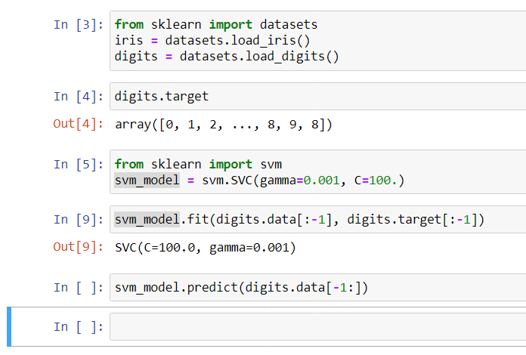
3. Scikit Learn
Contains a huge number of Machine Learning algorithms and other key performance-related libraries
Regression
Classification
Clustering
Model Selection
Dimensionality reduction and many more
Notes:
Screenshot is taken from a personal notebook

Slide 17
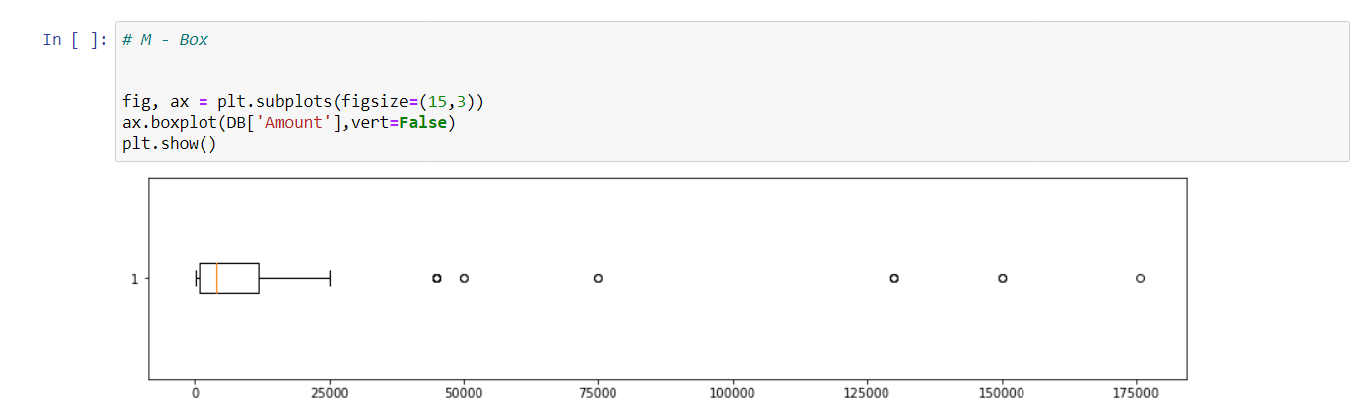
4. Matplotlib
Plotting library for the Python programming language and its numerical mathematics extension NumPy.
Most of the Matplotlib utilities lies under “pyplot” submodule.
Notes:
Screenshot is taken from a personal notebook

Slide 18
5. Seaborn
Visualization library for statistical graphics plotting in Python.
Built on the top of Matplotlib.
Closely integrated to the data structures from Pandas.
Seaborn divides plot into the below categories
Relational plots
Categorical plots
Distribution plots
Regression plots
Matrix plots
Multi plot grids
Examples: displot, boxplot, countplot, etc.

Slide 19
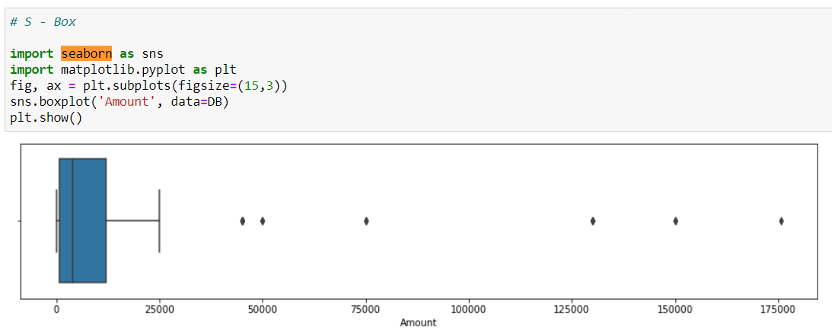
5. Seaborn
Notes:
Screenshot is taken from a personal notebook

Slide 20



Python Installation – Need For Editor
PYTHON IDEs (Integrated Development Environment)
A text editor helps to automate the tasks and enhance the productivity and efficiency of the developer.
Why IDE ? :
Provides an editor designed to handle code (with, for example, syntax highlighting and auto-completion).
Provides build, execution, and debugging tools.
Some form of source control.
Jupyter
IDLE
Notes:
Logos are taken from wikimedia commons
Link: https://commons.wikimedia.org/wiki/File:Python_logo_and_wordmark.svg

Slide 21
Python Installation – Anaconda Distribution
Anaconda distribution comes with over 250 packages automatically installed, and over 7,500 additional open-source packages can be installed from PyPI as well as the conda package.
Anaconda Individual Edition links:
1. Anaconda 5.2 For Linux Installer - https://www.anaconda.com/download/#linux 2. Anaconda 5.2 For macOS Installer - https://www.anaconda.com/download/#macos 3. Anaconda 5.2 For Windows Installer - https://www.anaconda.com/download/#windows (You need to download the version compatible with your OS.)

Slide 22
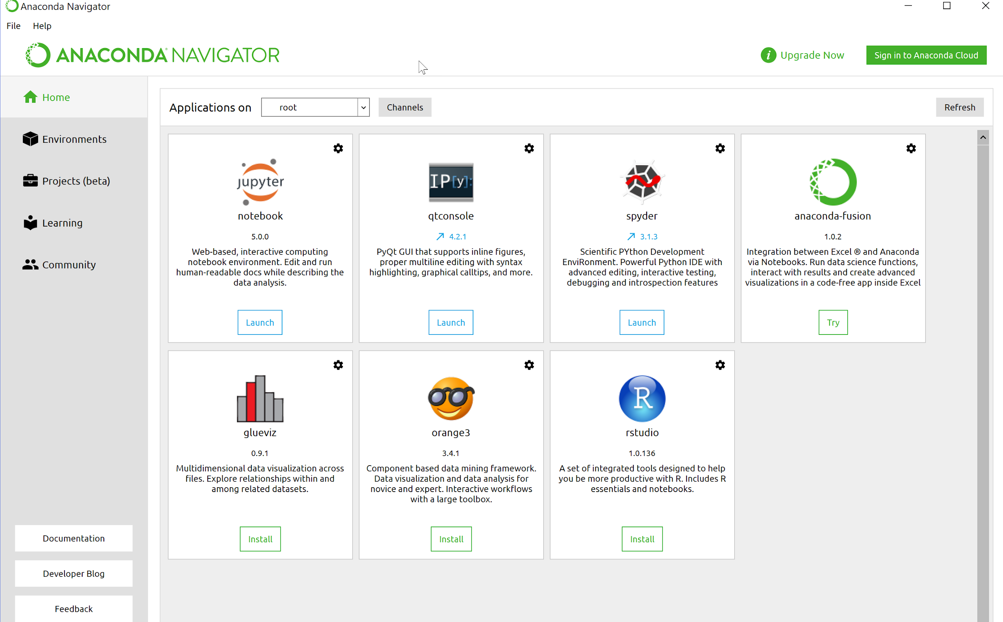
Anaconda Navigator
Notes:
Screenshot is taken from a personal system

Slide 23

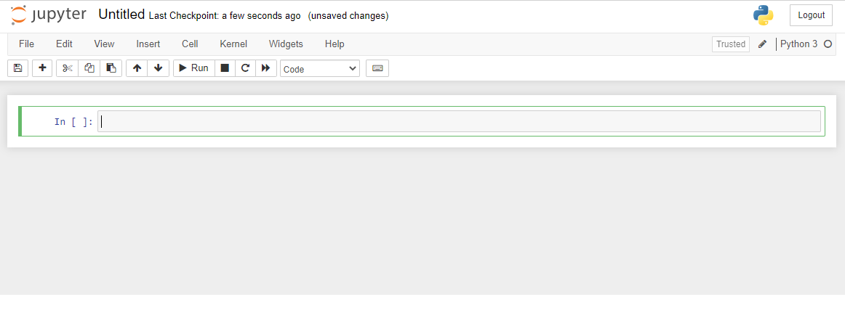
Jupyter Notebook For Python
An open source web application that you can use to create and share documents that contain live code, equations, visualizations, and text.
Anaconda navigator comes with Jupyter notebook.
Notes:
Screenshot is taken from a personal notebook

Slide 24
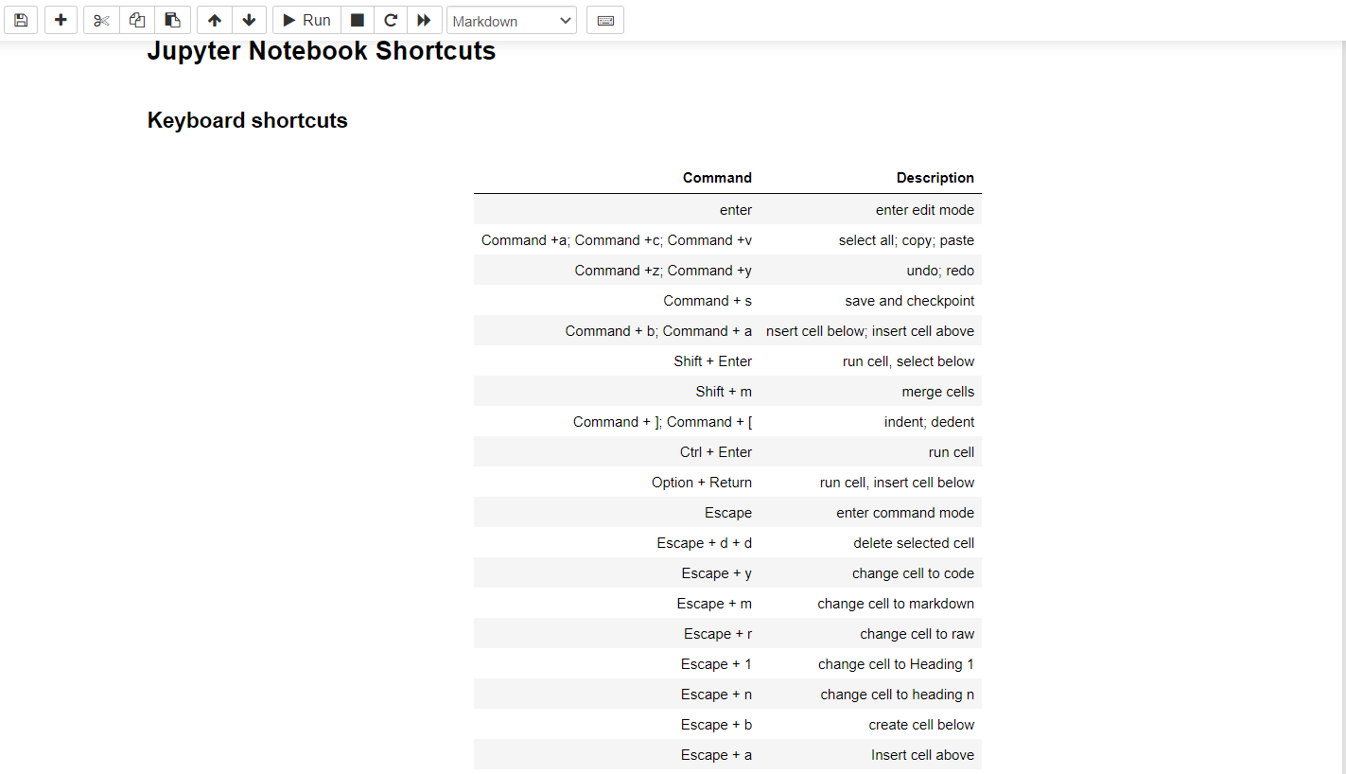
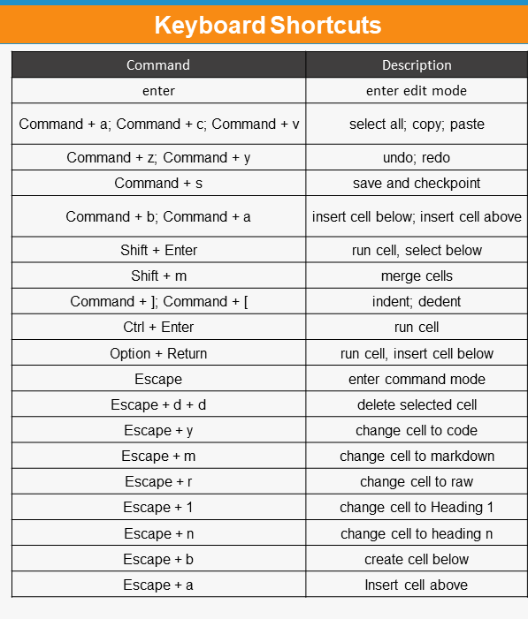
Jupyter Notebook Shortcuts
Notes:
Screenshot is taken from a personal notebook

Slide 25
Summary
Discussed need for python
Basic features of python
Variables and operators in python
Packages in Python
Editor and Jupyter

Slide 26
Numpy & Pandas
NumPy in Python
NumPy arrays
Functions to create array
NumPy Matrix
Indexing and slicing
Selection techniques
Pandas in Python
Series
Dataframe
Indexing
Loading and saving dataframes
Summary

Slide 27


Slide 28
Numpy
Arithmetic operations
Installation – conda install numpy
Usually imported with alias name np
Linear Algebra
Vector/ Matrix operations
Uses of NumPy
Random module
Broad-
casting
In built functions

Slide 29
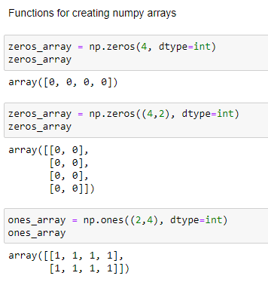
Functions To Create Specific Arrays
zeros()
ones()
empty()
eye()
identity()
empty_like()
zeros_like()
onces_like()
asarray()
full()
full_like()

Slide 30
Numpy Matrix
Designated 2 dimensional array
Has matrix multiplication and matrix squared operators
Returns a matrix of same dimension (2-D)

Slide 31
Difference Between Numpy ARRAY & Numpy Matrix
Difference | NumPy N-D Array Object | NumPy Matrix Object
Dimensionality | Multi-dimensional | 2 Dimensional
Multiplication with * operator | Element by element multiplication | Dot product
Multiplication with * * operator | Element wise squared operation | Matrix multiplication
Class | Base class | Derived class (Inherits from N-d array)
Inverse method | Do not have inverse method (.I) | Have inverse (.I) method
Usage/ Demand | Highly used | No longer recommended to use
NOTE: Matrix class is deprecated for future. Instead use Numpy arrays

Slide 32
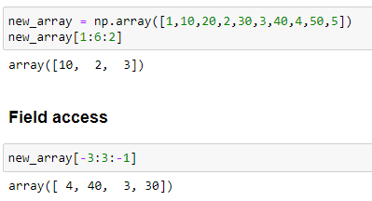
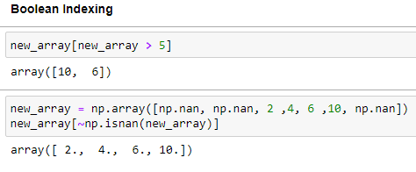
Indexing And Slicing
Field access
Slicing
Indexing
Integer
Advance indexing
Boolean

Slide 33

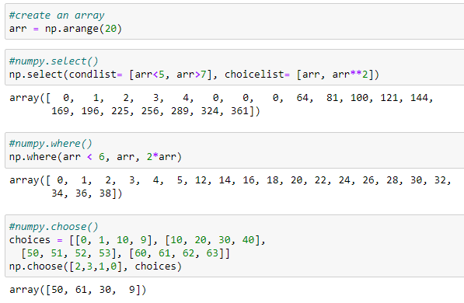
Numpy Selection Techniques
where()
choose()
select()
random.choice()
invert()

Slide 34
Common Numpy Functions
Function | Description
np.array() | To create an array
np.arange() | Return evenly spaced values within a given interval
np.linspace() | Return evenly spaced numbers over a specified interval
np.zeros() | To create an array of zeros
np.ones() | To create an array of ones
np.transpose() | Permute array dimensions

Slide 35
Common Numpy Functions
Function | Description
np.random.rand() | To create an array of specified shape filled with random values
np.random.randint() | Return random integers from low (inclusive) to high (exclusive)
np.random.randn() | Return a sample (or samples) from the “standard normal” distribution.
np.concatenate() | Concatenate two arrays
np.save() | Save an array to a binary file in .npy format.
np.savez() | Save several arrays into a single file in uncompressed .npz format.

Slide 36
Pandas

Slide 37
Pandas In Python
Reshaping Datasets
Build on top of NumPy
Supports data manipulation
Open source
Stable release – 1.3.0 / 2
Offer powerful data processing capabilities
Usually imported with alias name pd
Reading various forms Datasets
Manipulating the data
Splitting and modifying the Datasets
Pandas Capabilities
Merging, concatenating Datasets
Handling missing data
Indexing and Ranking
Grouping and filtering data

Slide 38
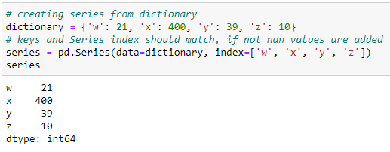
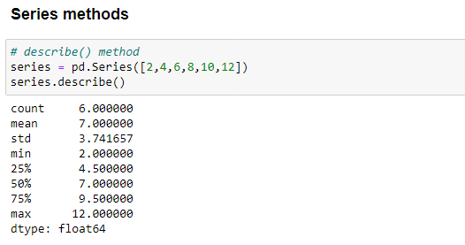
Pandas Series
One dimensional array which can hold any data type
Supports various methods:
append()
abs()
add()
agg()
describe()
all()
apply()
copy()
count()

Slide 39
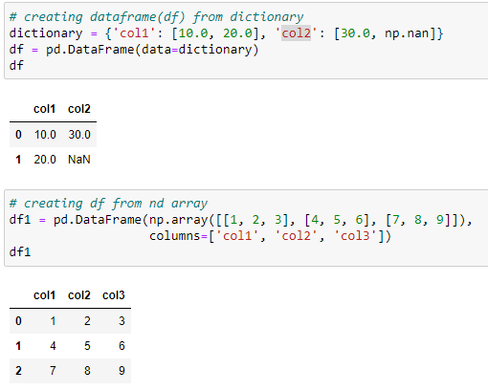
Pandas Dataframe
2 D tabular data structure
Similar to SQL table
Most widely used Pandas object
Like Series, input can be anything ( ndarray, dictionary, list, series, etc.)

Slide 40
Common Pandas Functions
Function | Description
df.value_counts() | To get count of some attributes
df.unique() | To get unique values
df.dtype | To get the data types
df.shape | To get the shape (number or rows and columns)
df.head() | To get the top rows
df.describe() | To get the quick statistic summary

Slide 41
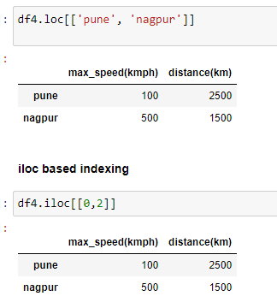
Pandas Indexing
Indexing can be done through .iloc[ ] , .loc[ ]
.loc[ ] uses label to select data
.iloc[ ] uses position (integer location) to select data

Slide 42
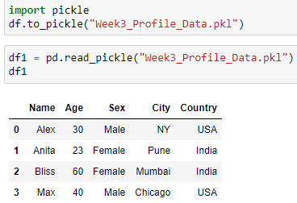
Loading And Saving Dataframe
Pickle : used for saving and loading Dataframe
df.to_pickle(filename)
pd.read_pickle(filename)
csv file : can save Dataframe using csv file
df.to_csv(filename)
pd.read_csv(filename)

Slide 43
Summary
Discussed Numpy arrays
Functions to create numpy arrays
Difference between numpy array and numpy matrix
Indexing and slicing
Numpy selection methods
Pandas in Python
Series and methods associated with it
Dataframe and methods associated with it
Indexing in Dataframe
Dataframe loading and saving

